Slide 1
Analog Transmission

Slide 2


















































5-2 ANALOG AND DIGITAL
Analog-to-analog conversion is the representation of analog information by an analog signal. One may ask why we need to modulate an analog signal; it is already analog. Modulation is needed if the medium is bandpass in nature or if only a bandpass channel is available to us.
Topics discussed in this section:
Amplitude Modulation
Frequency Modulation
Phase Modulation

Slide 3
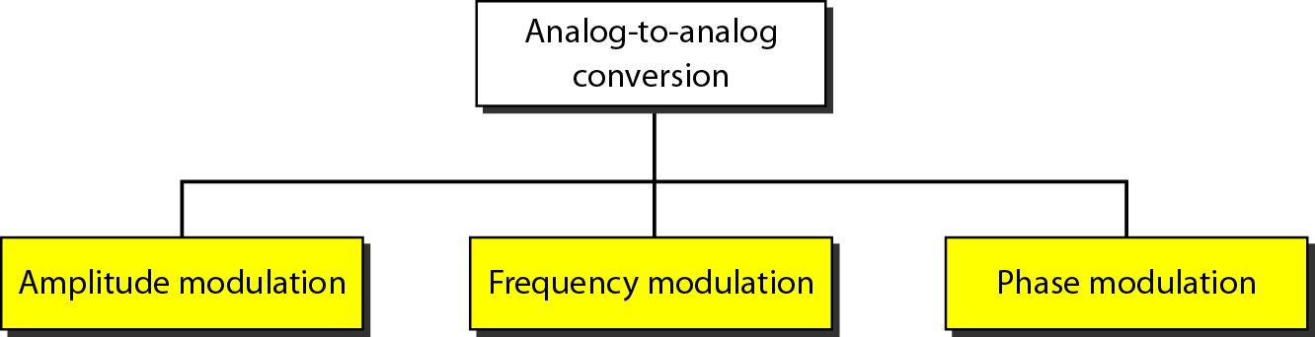
Figure 5.15 Types of analog-to-analog modulation

Slide 4
Amplitude Modulation
A carrier signal is modulated only in amplitude value
The modulating signal is the envelope of the carrier
The required bandwidth is 2B, where B is the bandwidth of the modulating signal
Since on both sides of the carrier freq. f_{c}, the spectrum is identical, we can discard one half, thus requiring a smaller bandwidth for transmission.

Slide 5
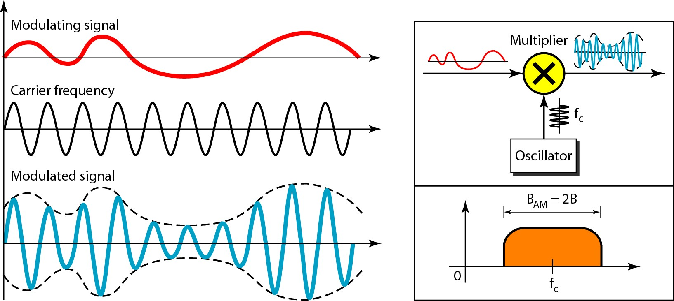
Figure 5.16 Amplitude modulation

Slide 6




Note
The total bandwidth required for AM can be determined
from the bandwidth of the audio signal: B_{AM} = 2B.

Slide 7
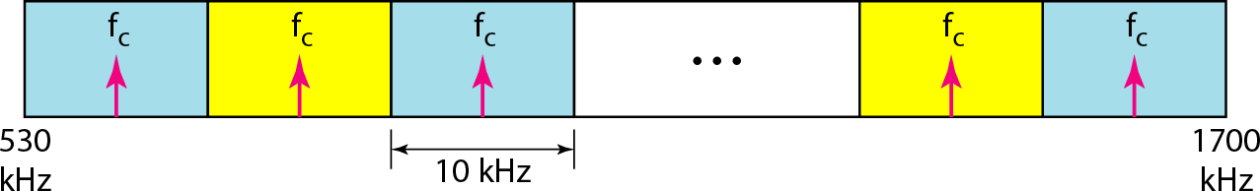
Figure 5.17 AM band allocation

Slide 8
Frequency Modulation
The modulating signal changes the freq. f_{c} of the carrier signal
The bandwidth for FM is high
It is approx. 10x the signal frequency

Slide 9
Note
The total bandwidth required for FM can be determined from the bandwidth
of the audio signal: B_{FM} = 2(1 + β)B. Where β is usually 4.

Slide 10
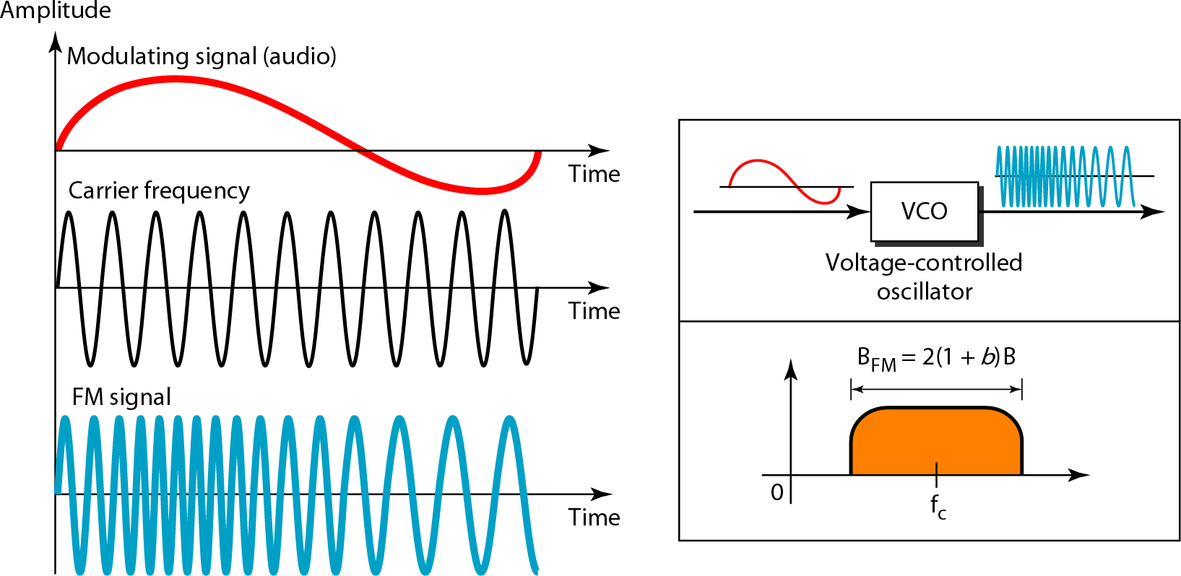
Figure 5.18 Frequency modulation

Slide 11
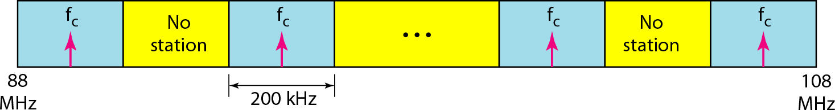
Figure 5.19 FM band allocation

Slide 12
Phase Modulation (PM)
The modulating signal only changes the phase of the carrier signal.
The phase change manifests itself as a frequency change but the instantaneous frequency change is proportional to the derivative of the amplitude.
The bandwidth is higher than for AM.

Slide 13
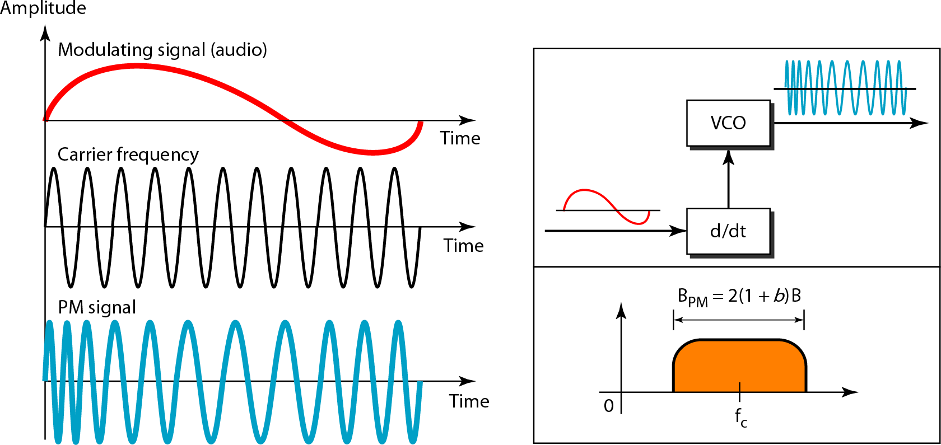
Figure 5.20 Phase modulation

Slide 14
Note
The total bandwidth required for PM can be determined from the bandwidth
and maximum amplitude of the modulating signal:
B_{PM} = 2(1 + β)B.
Where β = 2 most often.

